Slide 1
Ramanujan Junction
Source: AMSP Problems
Line Sketch 2

Slide 2

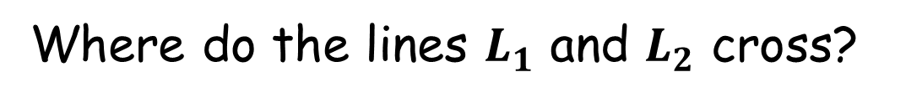


Ramanujan Junction
$$L_{1}$$
$(−102,46)$
$(−18,34)$
$(−19,21)$
$(−100,3)$
Where do the lines $L_{1}$ and $L_{2}$ cross?
$$L_{2}$$
(Not to scale)

Slide 3

Ramanujan Junction
$$L_{1}$$
$(−102,46)$
$(−18,34)$
$(−19,21)$
$(−100,3)$
Gradient of $L_{1}$:
$m_{1}=\frac{34 − 46 }{−18 −(−102)}=\frac{−12}{84}=−\frac{1}{7}$
Equation of $L_{1}$:
$\left(34\right)=−\frac{1}{7}\left(−18\right)+c$
$c=\frac{220}{7}$
$y=−\frac{1}{7}x+\frac{220}{7}$ or $7y+x=220$
$$L_{2}$$
(Not to scale)

Slide 4



Ramanujan Junction
$$L_{1}$$
Gradient of $L_{2}$:
$m_{2}=\frac{21 − 3 }{−19 −(−100)}=\frac{18}{81}=\frac{2}{9}$
Equation of $L_{2}$:
$\left(21\right)=\frac{2}{9}\left(−19\right)+c$
$c=\frac{227}{9}$
$y=\frac{2}{9}x+\frac{227}{9}$ or $9y−2x=227$
$(−102,46)$
$(−19,21)$
$(−100,3)$
$$L_{2}$$

Slide 5
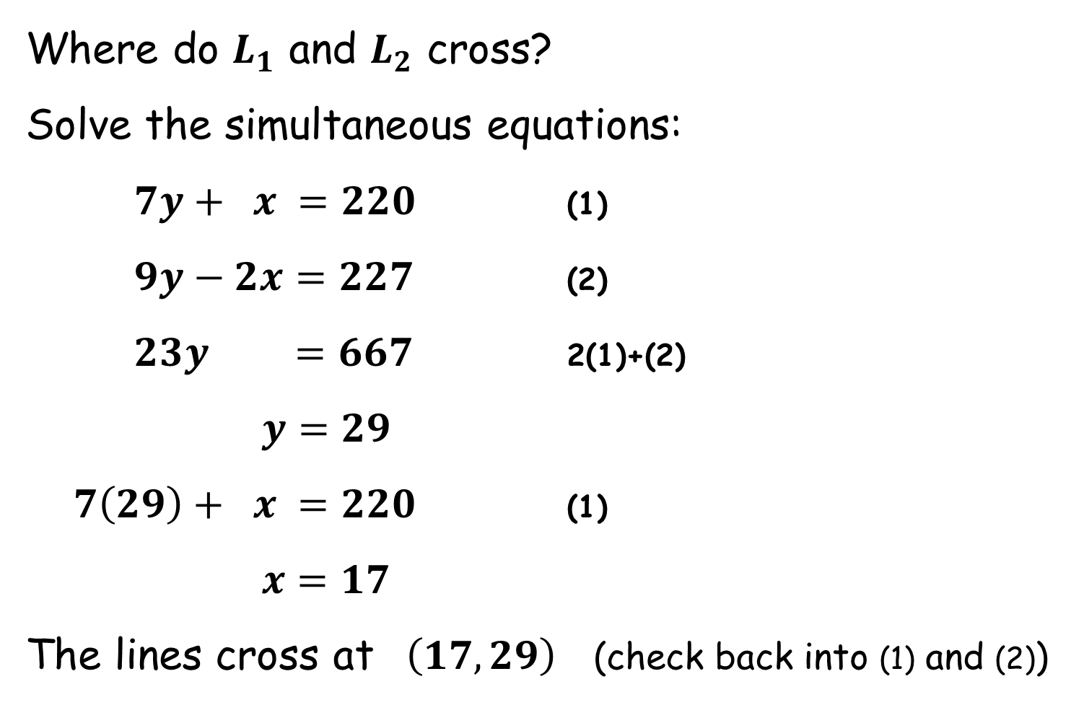
Ramanujan Junction
Where do $L_{1}$ and $L_{2}$ cross?
Solve the simultaneous equations:
$7y+ x =220$ (1)
$9y−2x=227$ (2)
$23y =667$ 2(1)+(2)
$y=29$
$7\left(29\right)+ x =220$ (1)
$x=17$
The lines cross at $\left(17,29\right)$ (check back into (1) and (2))

Slide 6
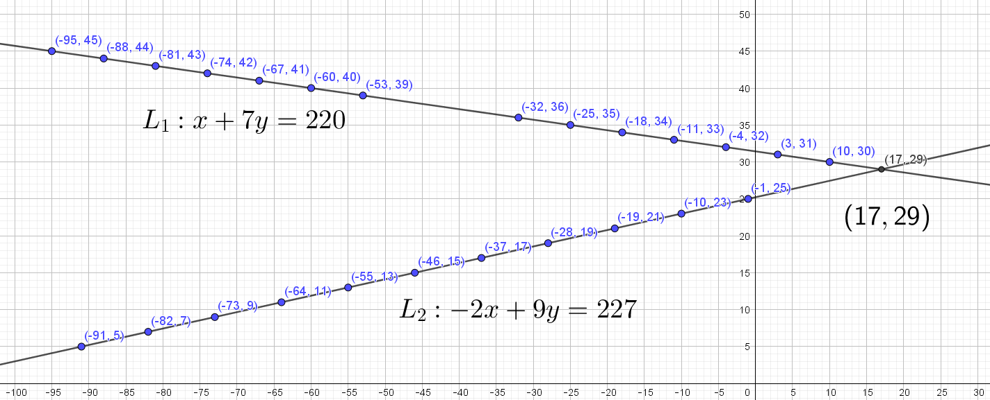


$$y$$
$$x$$

Slide 8
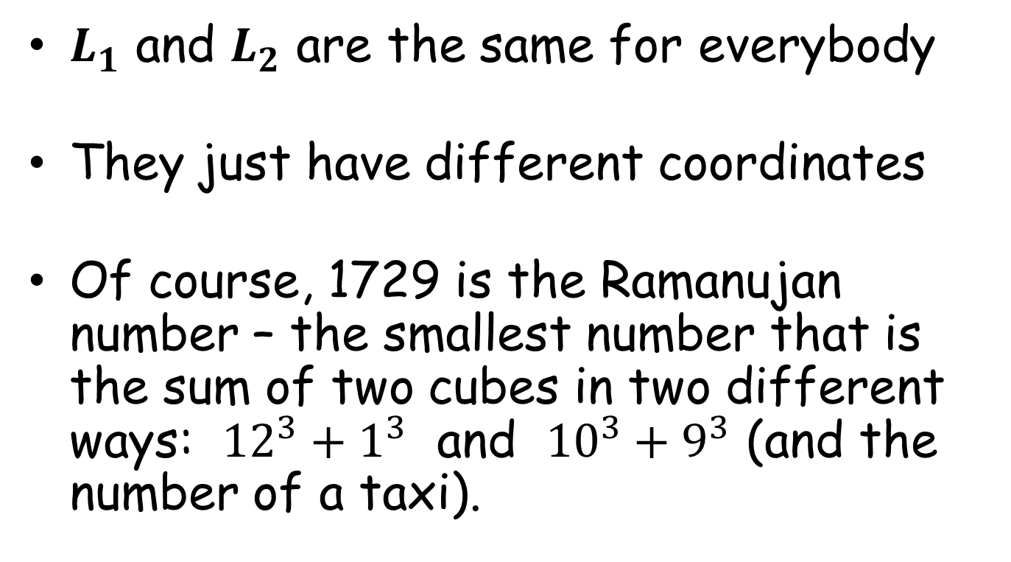
NOTE TO TEACHER
$L_{1}$ and $L_{2}$ are the same for everybody
They just have different coordinates
Of course, 1729 is the Ramanujan number – the smallest number that is the sum of two cubes in two different ways: ${12}^{3}+1^{3}$ and ${10}^{3}+9^{3}$ (and the number of a taxi).

Slide 10
RESOURCES

Slide 11


Ramanujan Junction
$$L_{1}$$
$(−95,45)$
$(−11,33)$
$(−10,23)$
$(−91,5)$
Where do the lines $L_{1}$ and $L_{2}$ cross?
$$L_{2}$$
(Not to scale)
$$A$$
SIC_71

Slide 12


Ramanujan Junction
$$L_{1}$$
$(−88,44)$
$(10,30)$
$(−10,23)$
$(−82,7)$
Where do the lines $L_{1}$ and $L_{2}$ cross?
$$L_{2}$$
(Not to scale)
$$B$$
SIC_71

Slide 13


Ramanujan Junction
$$L_{1}$$
$(−81,43)$
$(3,31)$
$(−1,25)$
$(−73,9)$
Where do the lines $L_{1}$ and $L_{2}$ cross?
$$L_{2}$$
(Not to scale)
$$C$$
SIC_71

Slide 14


Ramanujan Junction
$$L_{1}$$
$(−74,42)$
$(−11,33)$
$(−19,21)$
$(−64,11)$
Where do the lines $L_{1}$ and $L_{2}$ cross?
$$L_{2}$$
(Not to scale)
$$D$$
SIC_71

Slide 15


Ramanujan Junction
$$L_{1}$$
$(−67,41)$
$(−4,32)$
$(−10,23)$
$(−55,13)$
Where do the lines $L_{1}$ and $L_{2}$ cross?
$$L_{2}$$
(Not to scale)
$$E$$
SIC_71

Slide 16


Ramanujan Junction
$$L_{1}$$
$(−60,40)$
$(−18,34)$
$(−19,21)$
$(−46,15)$
Where do the lines $L_{1}$ and $L_{2}$ cross?
$$L_{2}$$
(Not to scale)
$$F$$
SIC_71

Slide 17


Ramanujan Junction
$$L_{1}$$
$(−53,39)$
$(−11,33)$
$(−28,19)$
$(−37,17)$
Where do the lines $L_{1}$ and $L_{2}$ cross?
$$L_{2}$$
(Not to scale)
$$G$$
SIC_71

Slide 18


Ramanujan Junction
$$L_{1}$$
$(−95,45)$
$(−4,32)$
$(−10,23)$
$(−73,9)$
Where do the lines $L_{1}$ and $L_{2}$ cross?
$$L_{2}$$
(Not to scale)
$$H$$
SIC_71

Slide 19


Ramanujan Junction
$$L_{1}$$
$(−95,45)$
$(−25,35)$
$(−28,19)$
$(−82,7)$
Where do the lines $L_{1}$ and $L_{2}$ cross?
$$L_{2}$$
(Not to scale)
$$I$$
SIC_71

Slide 20


Ramanujan Junction
$$L_{1}$$
$(−88,44)$
$(−18,34)$
$(−1,25)$
$(−73,9)$
Where do the lines $L_{1}$ and $L_{2}$ cross?
$$L_{2}$$
(Not to scale)
$$J$$
SIC_71

Slide 21


Ramanujan Junction
$$L_{1}$$
$(−81,43)$
$(3,31)$
$(−10,23)$
$(−64,11)$
Where do the lines $L_{1}$ and $L_{2}$ cross?
$$L_{2}$$
(Not to scale)
$$K$$
SIC_71

Slide 22


Ramanujan Junction
$$L_{1}$$
$(−74,42)$
$(10,30)$
$(−37,17)$
$(−46,15)$
Where do the lines $L_{1}$ and $L_{2}$ cross?
$$L_{2}$$
(Not to scale)
$$L$$
SIC_71

Slide 23


Ramanujan Junction
$$L_{1}$$
$(−67,41)$
$(3,31)$
$(−1,25)$
$(−19,21)$
Where do the lines $L_{1}$ and $L_{2}$ cross?
$$L_{2}$$
(Not to scale)
$$M$$
SIC_71

Slide 24


Ramanujan Junction
$$L_{1}$$
$(−60,40)$
$(−32,36)$
$(−37,17)$
$(−55,13)$
Where do the lines $L_{1}$ and $L_{2}$ cross?
$$L_{2}$$
(Not to scale)
$$N$$
SIC_71

Slide 25


Ramanujan Junction
$$L_{1}$$
$(−53,39)$
$(3,31)$
$(−19,21)$
$(−46,15)$
Where do the lines $L_{1}$ and $L_{2}$ cross?
$$L_{2}$$
(Not to scale)
$$O$$
SIC_71

Slide 26


Ramanujan Junction
$$L_{1}$$
$(−88,44)$
$(3,31)$
$(−10,23)$
$(−46,15)$
Where do the lines $L_{1}$ and $L_{2}$ cross?
$$L_{2}$$
(Not to scale)
$$P$$
SIC_71

